Slide 1
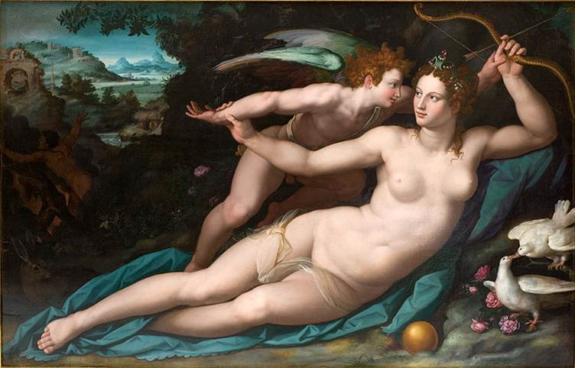

Alessandro Allori (1535-1607)
Italian painter
Venus and Cupid

Slide 2
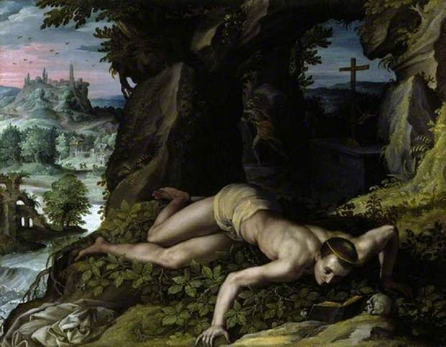
The Temptation of St Benedict

Slide 3
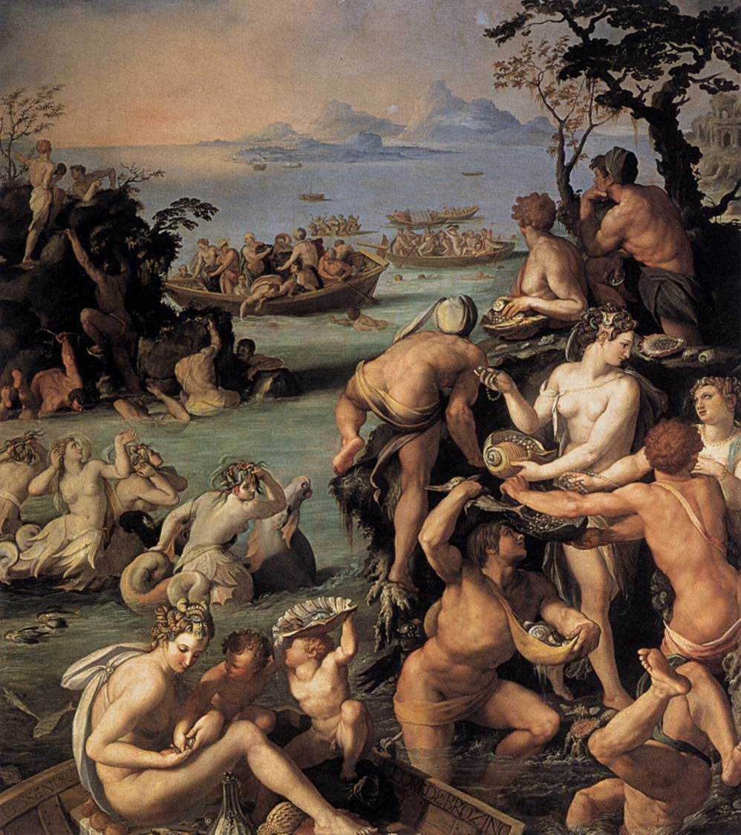
Pearl Fishers

Slide 4
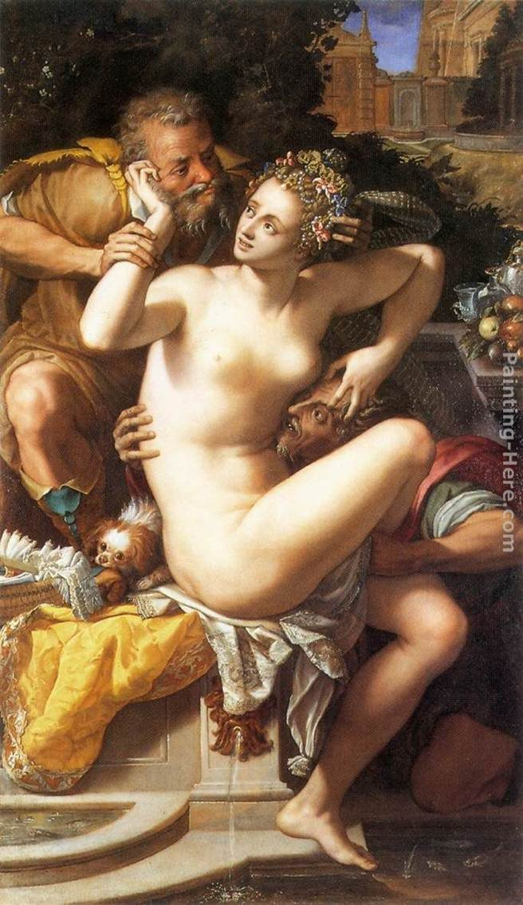
Susanna and The Elders

Slide 5
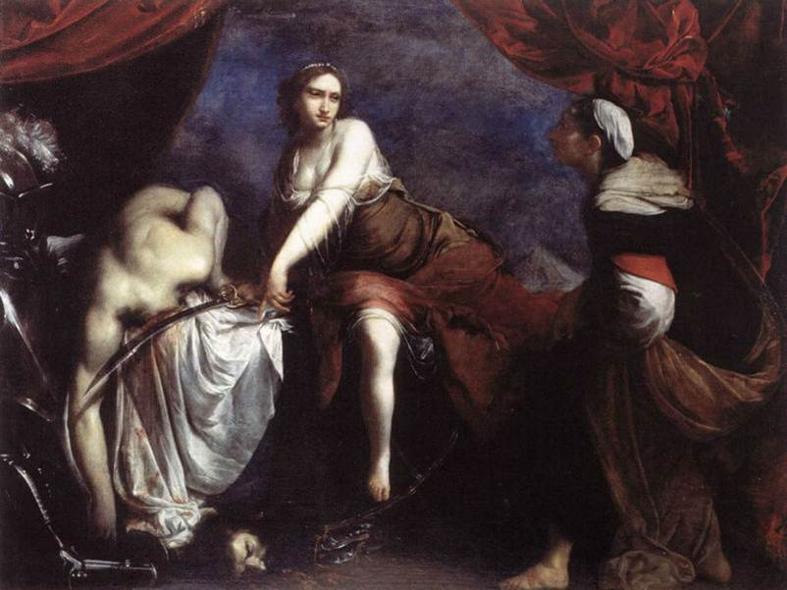
Judith and Holofernes

Slide 6
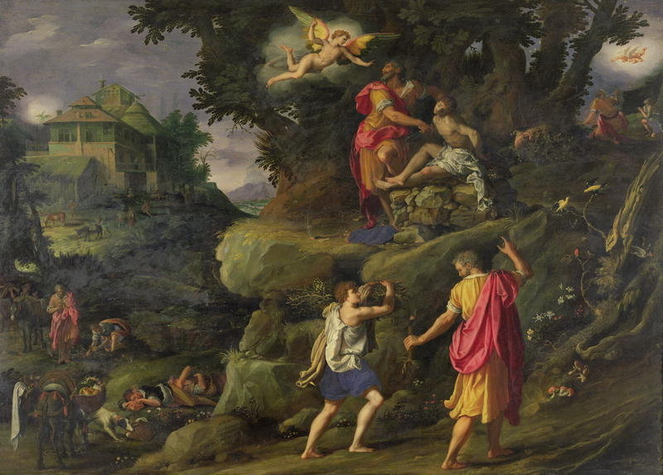
Sacrifice of Isaac
Notes:
Sacrifice of Isaac

Slide 7
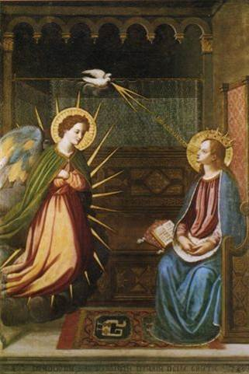
Annunciation

Slide 8
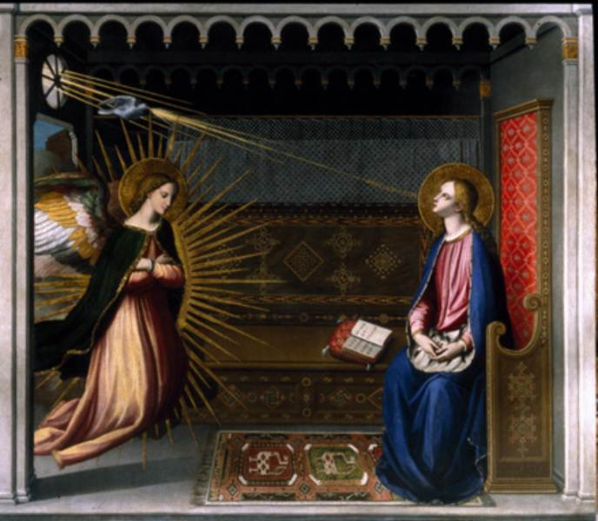
Annunciation

Slide 9
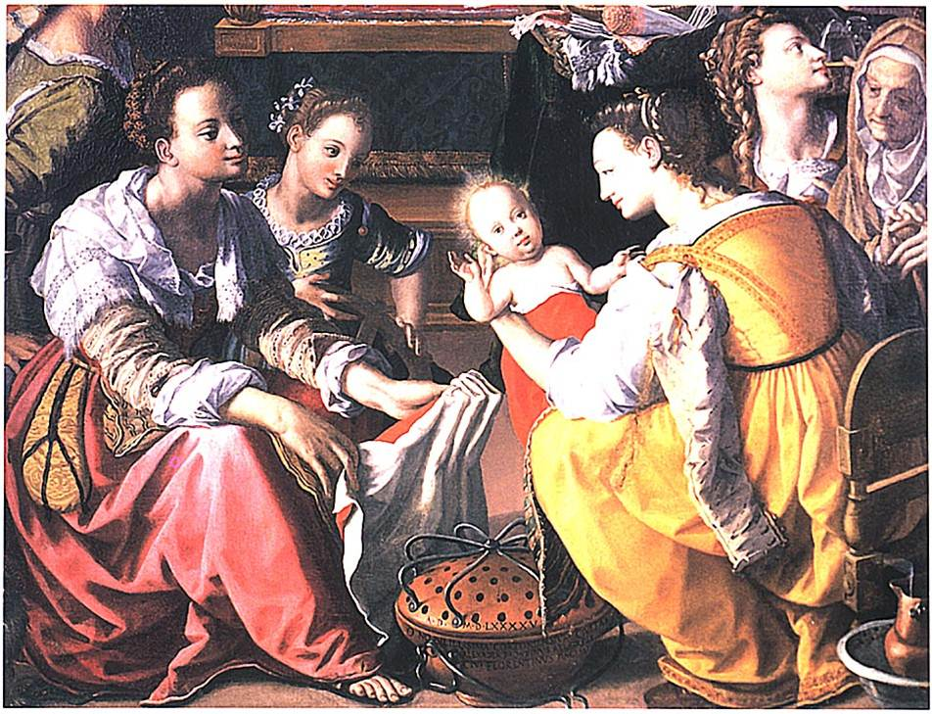
Birth of the Virgin

Slide 10
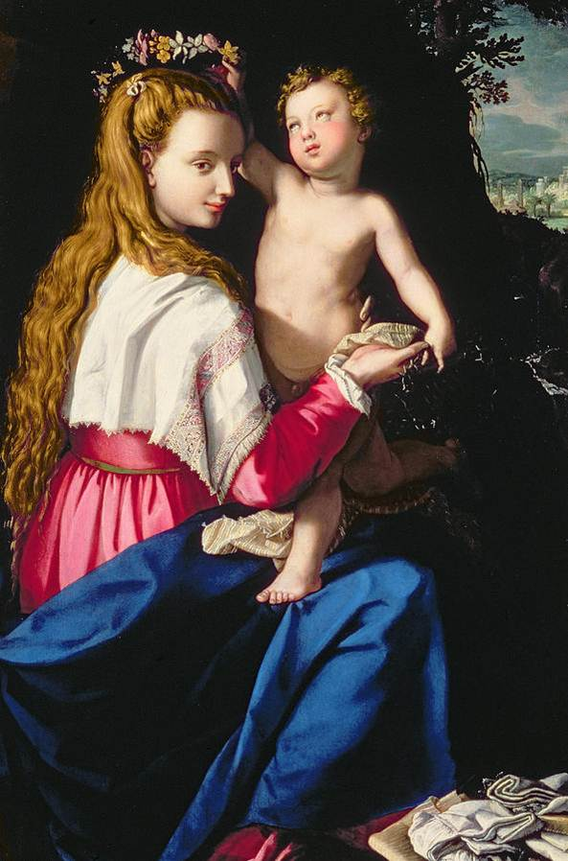
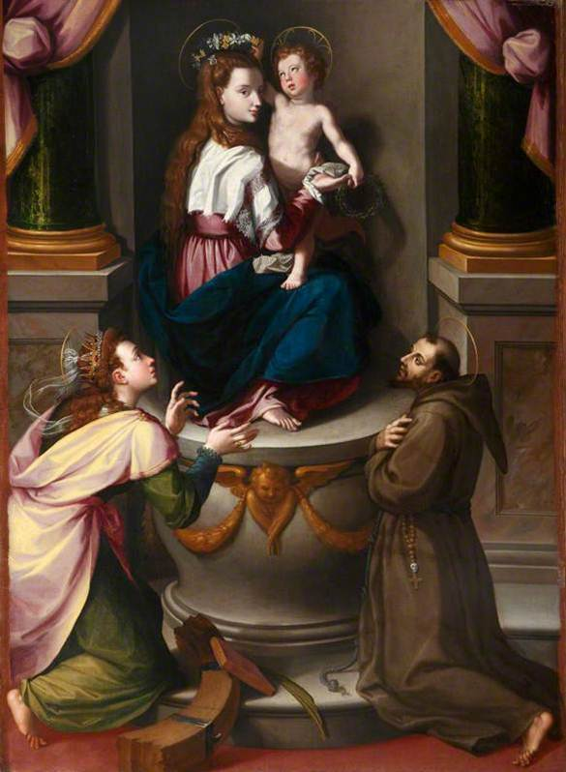
Madonna and Child

Slide 11
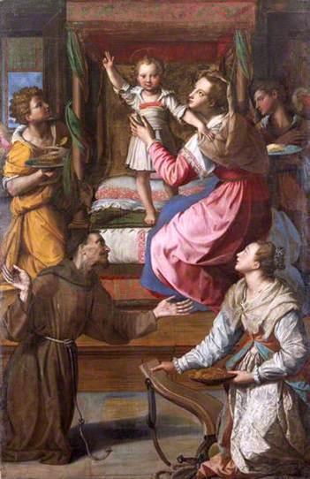
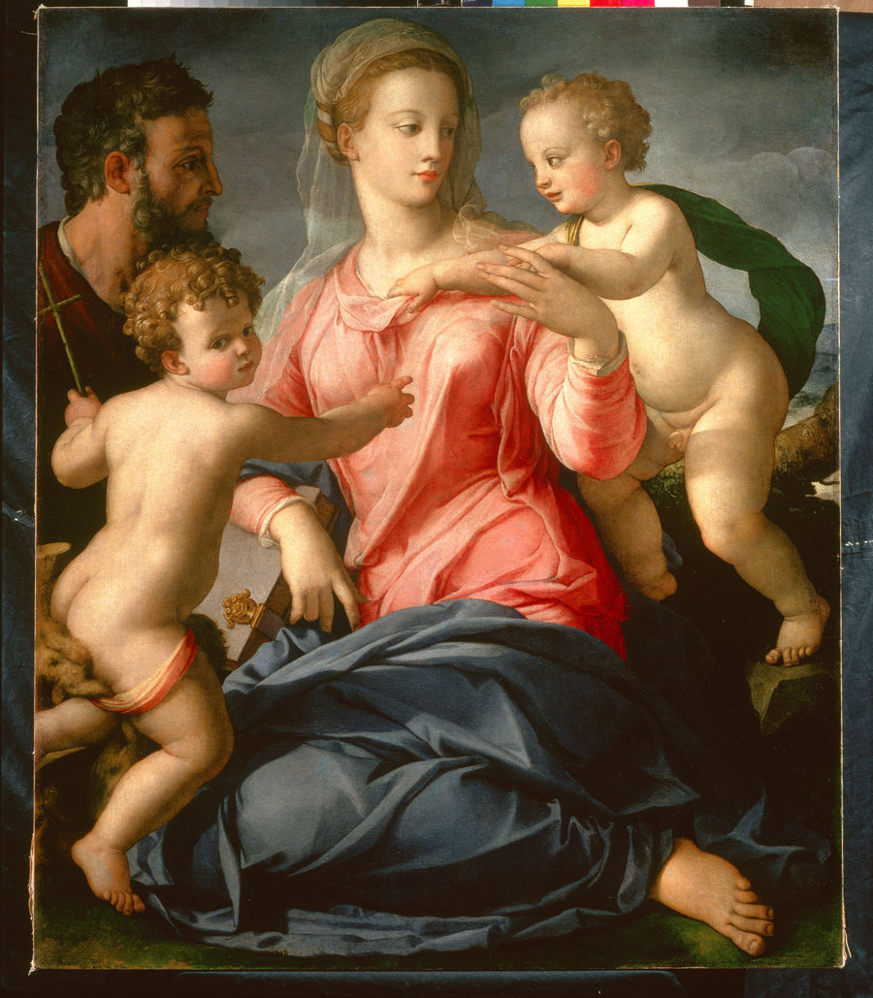
Virgin and Child
Holy Family

Slide 12
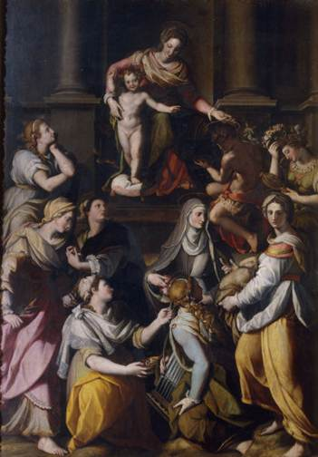
Madonna and Child,
the boy John and eight female saints

Slide 13
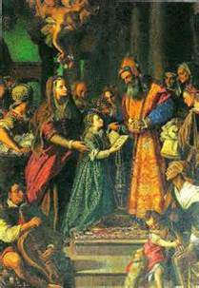
Presentation of Virgin

Slide 14
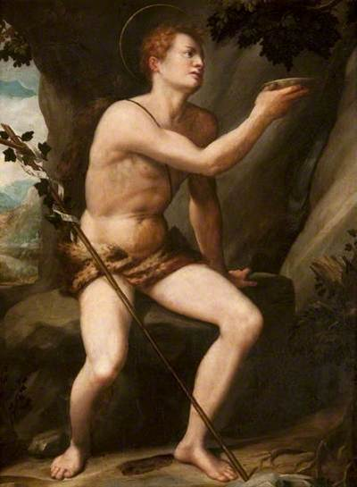
Saint John the Baptist

Slide 15
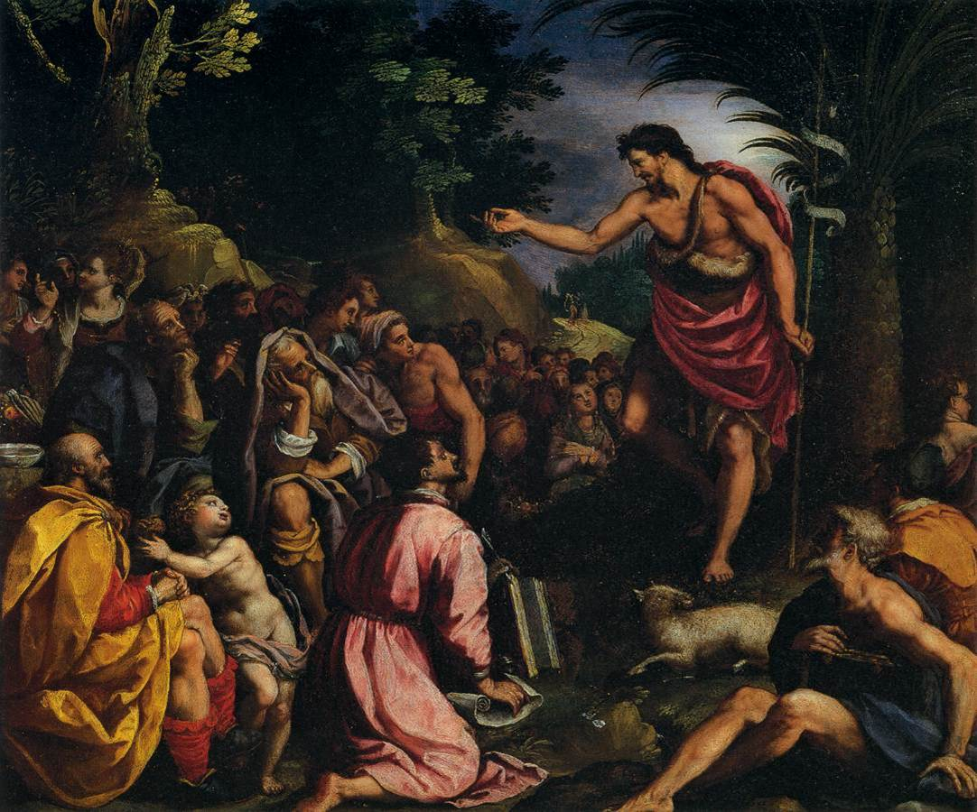
The Preaching of St John the Baptist

Slide 16
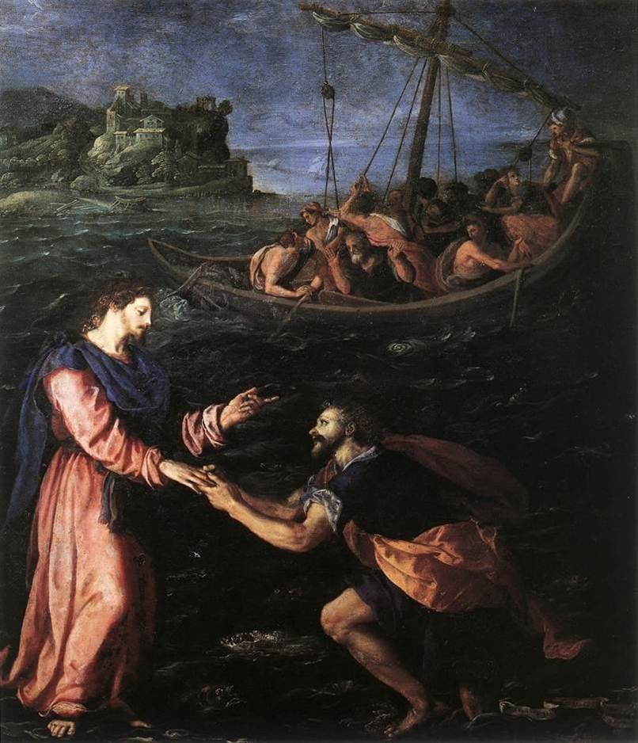
St Peter
Walking on the Water

Slide 17
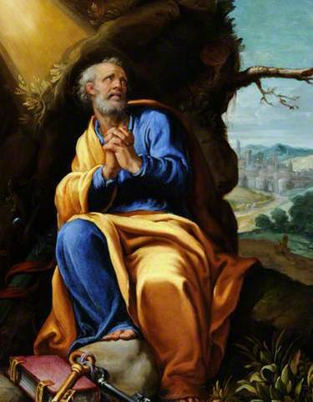
St Peter

Slide 18
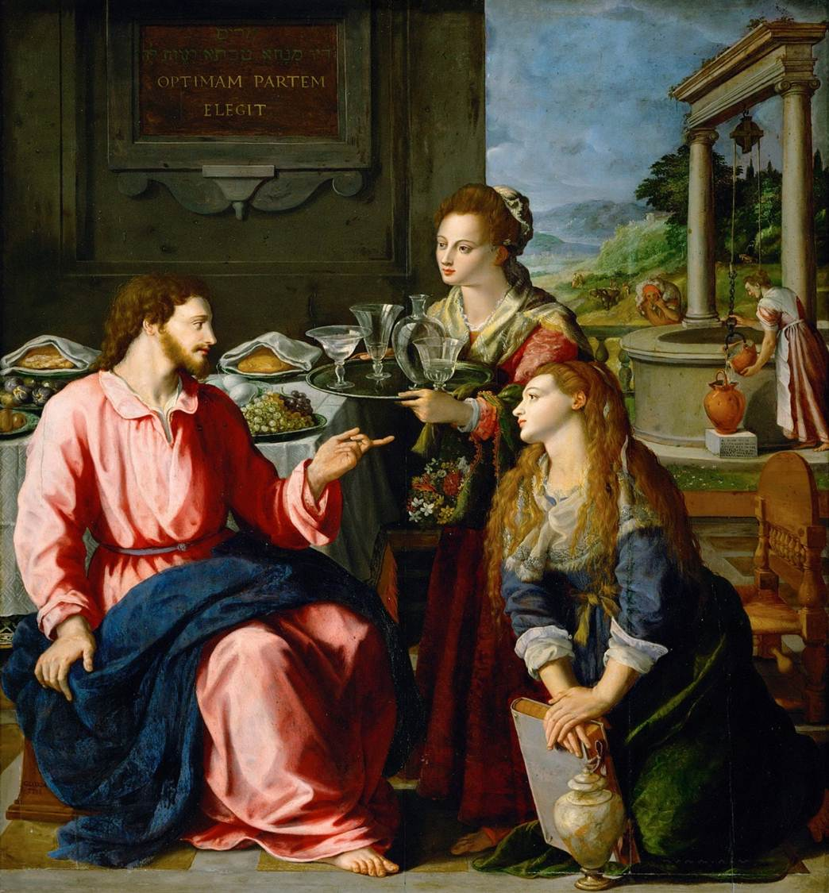
Christ
with Mary and Martha

Slide 19
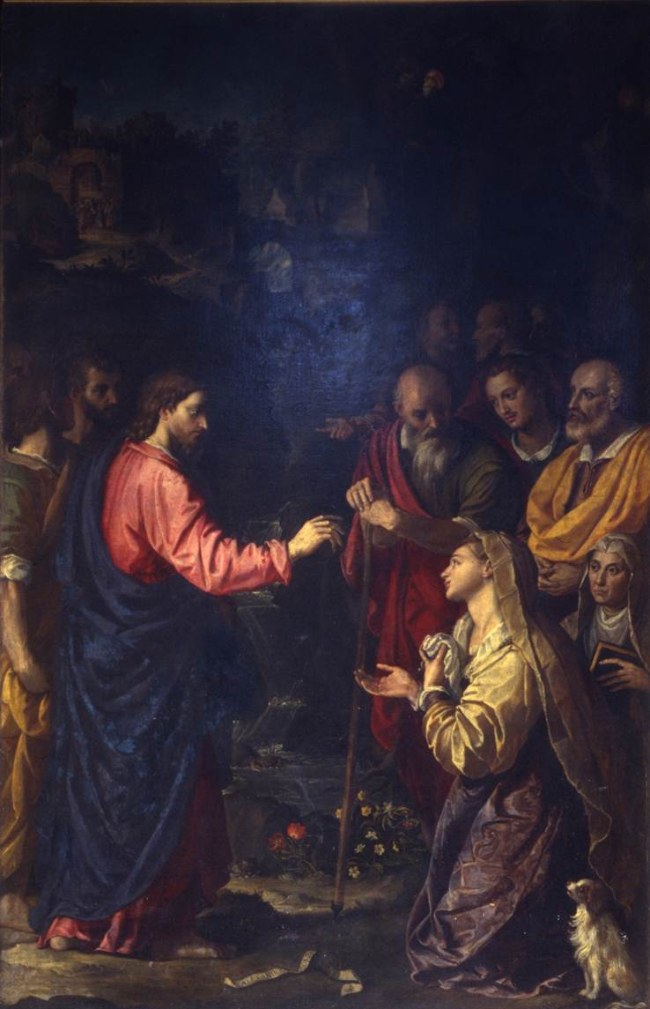

Slide 20
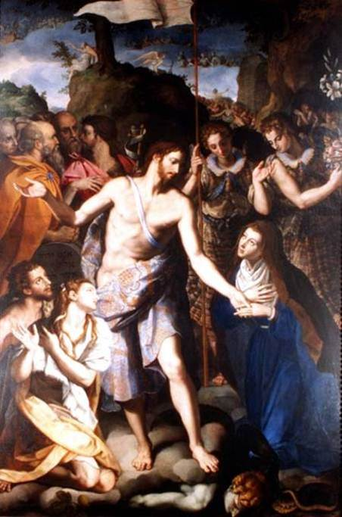
Christ's Descent into Limbo

Slide 21
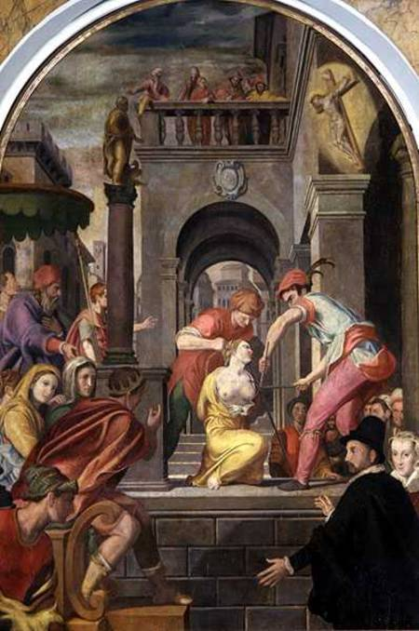
The Martyrdom of St. Agatha

Slide 22
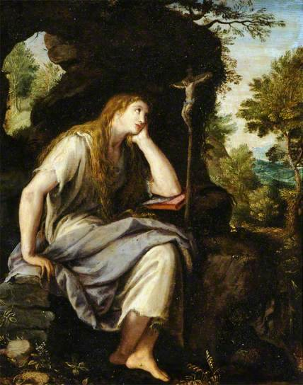
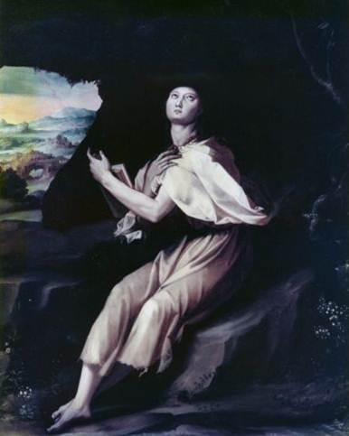
The Penitent Magdalena

Slide 23
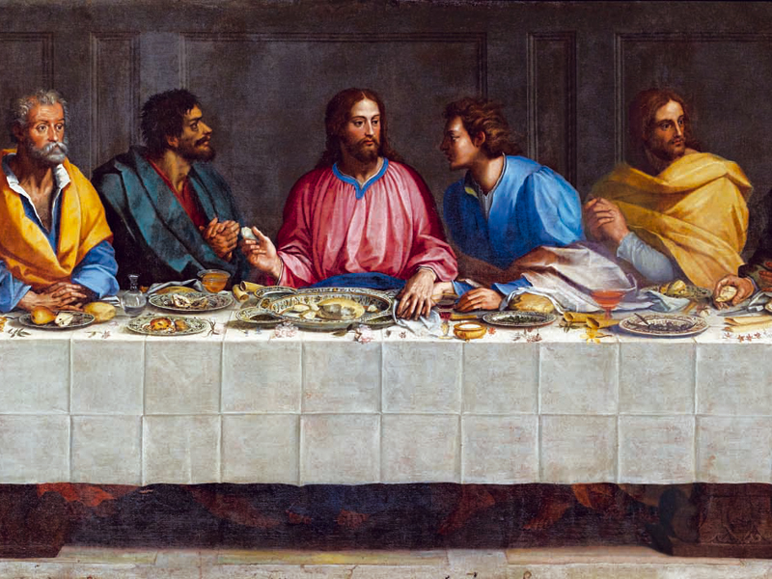
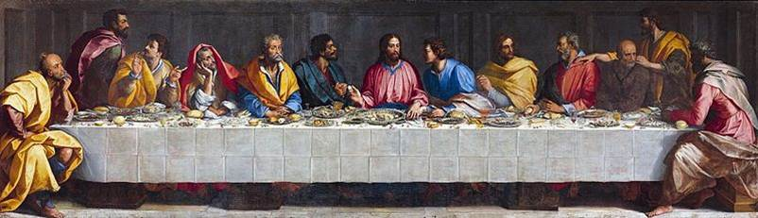
Last Supper

Slide 24
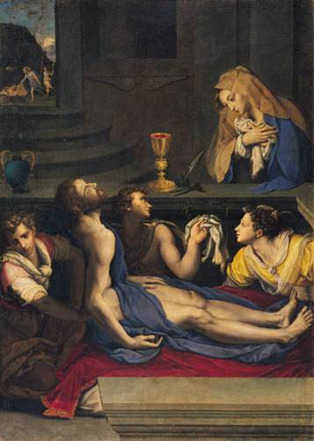
Pietà

Slide 25
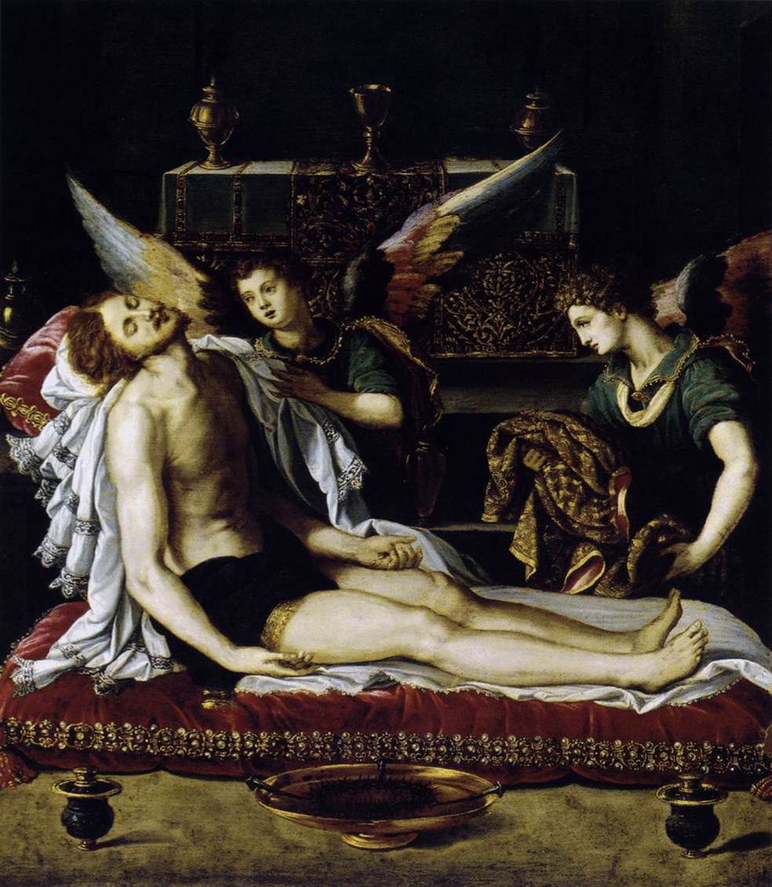
The Body of Christ
with Two Angels

Slide 26
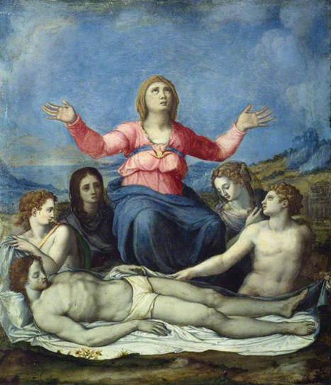
END
Lamentation
over the Dead Christ

